Slide 1
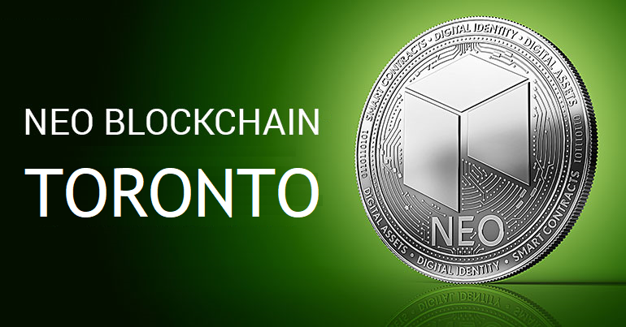
NEO Blockchain TORONTO
Welcome Neoxplorers!
Michael Herman
https://www.meetup.com/NEO-Blockchain-Toronto/
neotoronto@outlook.com

Slide 2
Agenda
Introductions
What is NEO?
Why do things have value?
NEO Smart Economy
Why NEO?
NEO Events
NEO Resources

Slide 3
Who is Michael Herman?
Past: Decades of experience on the Microsoft platform, Alberta cattle rancher, scuba diver and downhill skier
Now: Work 16 hours a day on the NEO Blockchain
Independent Developer
NEO Blockchain C# Center of Excellence
NEO City of Zion (CoZ)
Michael Herman is a independent developer and writer who contributes to several NEO Blockchain projects including:
NEO developer tool suite (neo-debugger and neo-gui-developer projects)
mwherman2000/neo-persistableclasses project – home of the NEO Persistable Class Framework (NPC) for efficient object-oriented smart contract development using C#.NEO
mwherman2000/dotnetquickstart project – home of the NEO Blockchain Quick Start Guide for .NET Developers.
Michael is also the founder of the NEO Blockchain C# Center of Excellence as well as the first Canadian NEO Blockchain Meetup group (NEO Blockchain Toronto). He has helped bootstrap several additional Meetups worldwide including NEO Blockchain Vancouver, NEO Blockchain Cancun, and NEO Blockchain Turkey.

Slide 4
What is NEO Blockchain Toronto?
NEO Blockchain Toronto (https://www.meetup.com/NEO-Blockchain-Toronto/) is a non-profit, community-based Meetup group for blockchain developers and architects interested in designing and creating Distributed Ledger Technology (DLT) (aka blockchain) solutions using the NEO Blockchain platform.
We call ourselves Neoxplorers
Meetup second Wednesday evening of each month
March 14, April 11, May 9, June 13, …
This meetup is a group that it is independent of but supported by the NEO Project (https://github.com/neo-project).

Slide 5
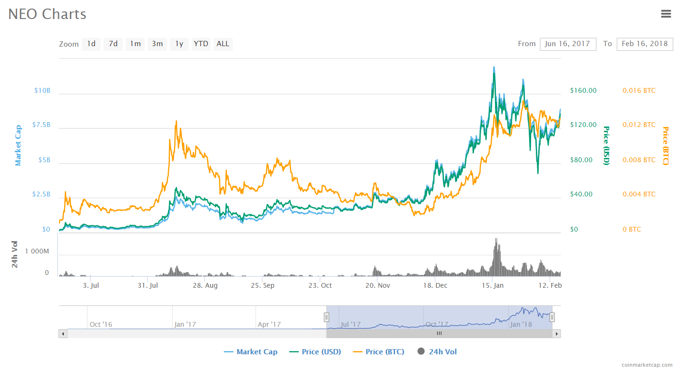
What is NEO?
PROJECT: NEO (https://neo.org/) is a non-profit, community-based blockchain project that utilizes blockchain technology and digital identity to digitize assets, to automate the management of digital assets using smart contracts, and to realize a "smart economy" with a distributed network.
DUAL CRYPTOCURRENCY: $NEO and $GAS
SOFTWARE PLATFORM: Programmable Smart Contract blockchain platform
Multiple languages: C# (reference implementation), Python, Java, Golang, JavaScript
NEO SMART ECONOMY
GLOBAL COMMUNITY
Discord: https://discord.gg/gqCYeup / https://discord.gg/4TQujHj
NEO C# Developers Center of Excellence (neo-csharpcoe) https://github.com/mwherman2000/neo-csharpcoe/blob/master/README.md
City of Zion “Home of the Open-source Global NEO Developer Community” https://cityofzion.io/

Slide 6



What is the NEO Smart Economy?
Digital Assets
+
NEO
Smart Economy
Digital Identity
+
Smart Contracts
Future world where the boundary between real assets in the physical world and digital assets in the digital world has been removed.

Slide 7
Two Cryptocurrencies: NEO and GAS
In the NEO Smart Economy…
NEO represents Voting Power - not divisible
GAS represents Ability to Fund Work (Systems Fees) - divisible
NEO
Should hold and retain NEO to maximize your voting power
Receive distributions of GAS
GAS
Used to fund the deployment of smart contracts (applications) on the NEO Blockchain
Used to fund transactions executed on the NEO Blockchain
Transfers of NEO from sender to receiver
Transfers of tokens from sender to receiver
Invoke operations in smart contract that update the state of the NEO Blockchain
Operations that just read state (data) back from the NEO Blockchain are essentially free
System fees are recycled and re-distributed back in ratio/proportion to the number of NEO you hold

Slide 8
NEO System Fees
 | NEO [Gas] |  |  | NEO [Gas]
Runtime.CheckWitness | 0.2 |  | OpCode.PUSH16 [or less] | 0.00
Blockchain.GetHeader | 0.1 |  | OpCode.NOP | 0.00
Blockchain.GetBlock | 0.2 |  | OpCode.APPCALL | 0.01
Blockchain.GetTransaction | 0.1 |  | OpCode.TAILCALL | 0.01
Blockchain.GetAccount | 0.1 |  | OpCode.SHA1 | 0.01
Blockchain.GetValidators | 0.2 |  | OpCode.SHA256 | 0.01
Blockchain.GetAsset | 0.1 |  | OpCode.HASH160 | 0.02
Blockchain.GetContract | 0.1 |  | OpCode.HASH256 | 0.02
Transaction.GetReferences | 0.2 |  | OpCode.CHECKSIG | 0.10
Account.SetVotes | 1 |  | OpCode.CHECKMULTISIG [per signature] | 0.10
Validator.Register | 1000 |  | Other OpCodes | 0.001
Asset.Create （system asset） | 5000
Asset.Renew （system asset） | 5000
Contract.Create | 500
Contract.Migrate | 500
Storage.Get | 0.1
Storage.Put [per KB] | 1.0
Storage.Delete | 0.1
Other OpCodes | 0.001

Slide 9
Why do things have value? Why do they appreciate? Michael’s Theorem
It’s all about Scarcity
Real or perceived
Simpler terms: Supply and Demand (but I prefer the term scarcity)
The difficulty or cost of acquiring new or additional assets
Money, diamonds, gold, ..., cryptocurrencies
The difficulty or cost of product or manufacturing new assets
Bitcoin, Ethereum (ETH)
Proof of State (PoS) concensus/verification processes
Millions of miners competing: HUGELY wasteful, expensive, slow
Could be through the regulation of price and/or supply – illusion of scarcity
“Mining is a process of validating a transaction or block in a network by the process of complex algorithms to prove and validate the correctness of the transaction and thereby add the new block to the chain.” [https://medium.com/@karthik.seshu/cryptocurrency-proof-of-work-vs-proof-of-stake-e1eee1420b10 ]

Slide 10
What happens when things become easier to acquire? Michael’s Theorem
What happens when things become easier to make/manufacture?
What happens to the price of ETH when Ethereum moves to Proof of Work (PoW)?
Millions of competing miners aren’t needed for Ethereum anymore
Maybe they move back into Bitcoin mining – perhaps driving down the cost of a Bitcoin?
NEO Blockchain uses Delegated Byzantine Fault Tolerance (dBFT)
Currently runs 8 nodes WW to support about 1000TPS throughput
By 2020, NEO estimates this will need to grove to 12 nodes to achieve 100,000TPS
Very small number of nodes

Slide 11




Problems with Proof of Work (PoW) and Proof of State (PoS)
1. Proof of Work (PoW)
2. Proof of Stake

Slide 12
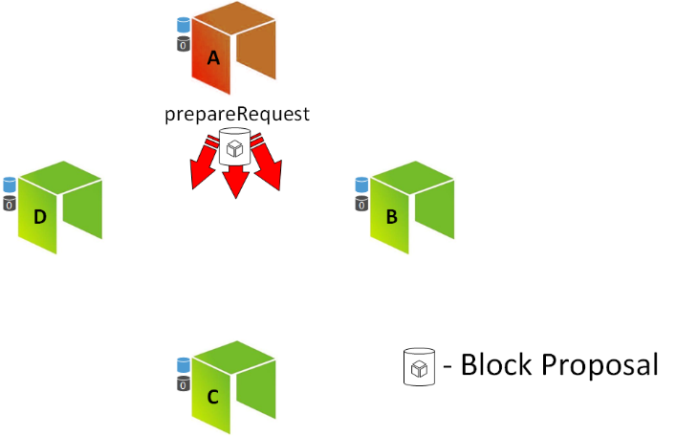
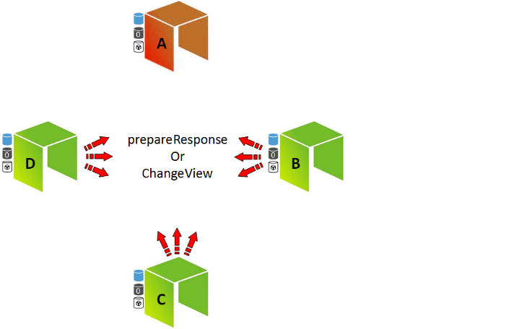
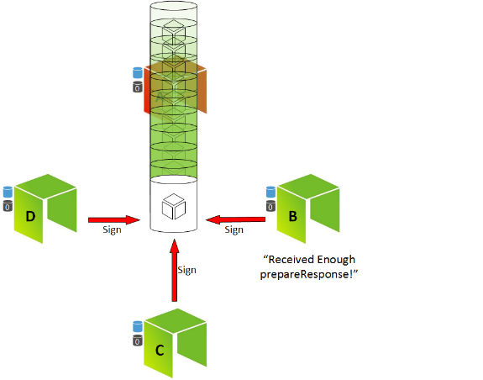
Delegated Byzantine Fault Tolerance (dBFT) NEO Consensus Algorithm

Slide 13
PoW and PoS compared to dBFT
Consensus algorithm: PoW and PoS
Consensus algorithm: dBFT
One and only one branch

Slide 14
The Problems with PoW* and PoS*
This structure is however in direct conflict with the interest of decentralized applications.
Many large scale applications need the transactions to be free of charge for the end user, while still ensuring stable service (transaction time). This will always be a conflict of interest for PoW and PoS systems.
Block creators are incentivized by economic rewards
If a transaction does not include a transaction fee, then the block creators have no interest in resolving it.
This is just how PoW and PoS has to be structured. If there is no economic reward in creating blocks, then there will be less nodes participating in the network, directly influencing network security.
*PoW - Proof of Work
*PoS - Proof of State

Slide 15
How Transaction Fees are Discouraged in the NEO Smart Economy
1
Each NEO token equals one vote for consensus nodes.
2
Consensus nodes may choose to refuse throughput upgrades because they have economic interest in transaction fees.
3
NEO holders only get system fees distributed to them, not transaction fees. More network usage equals more system fees, so NEO holders will work for increasing network throughput.
4
Because of point 3, consensus nodes that refuse throughput upgrades will not be re-voted as consensus nodes and other consensus nodes will be voted in.
5
Points 1-4 ensure that transaction fees are zero or near zero. Enterprises that want a decentralized application can safely develop on the NEO Blockchain without being worrying that their users may have difficulties in attaining the tokens they need.

Slide 16
NEO Blockchain as a Enterprise Application Platform
Let’s compare/contrast the Ethereum and the NEO Blockchain from a software platform perspective
Ethereum
NEO
Smart contract == single object/entity with a simple set of methods and simple types of data
The Ideal Application?
Blockchain version 2.0 Alt tokens
Simple, single entity with a few methods
Beyond that?
Very little future for Ethereum as an Enterprise Application platform
Smart contract == a program capable of working with few up to dozens of different types of objects/entities
Unlimited potential as an Enterprise Application Platform
Will drive acquisition of NEO
Automatic accumulation of GAS
Increased ability to participate in the NEO Smart Economy
Voting as well as having operating funds

Slide 17
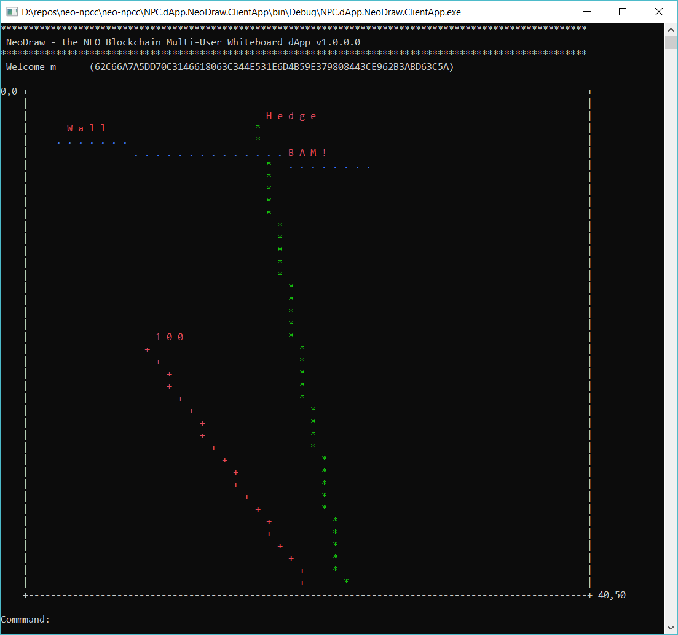
NEO Blockchain as a Enterprise Application Platform NeoDraw - NEO Multi-Person Shared Whiteboard dApp
NeoDraw is advanced proof-of-concept distributed application (dApp) for the NEO Persistable Classes (NPC) Entity-based dApp (e-dApp) Platform running on the NEO Blockchain.
Uses 3 entities
UserCredentials
User name and User Password
UserPoint
Array of (X,Y) coordinates/user
NeoCounter
Tracks number points/user

Slide 18
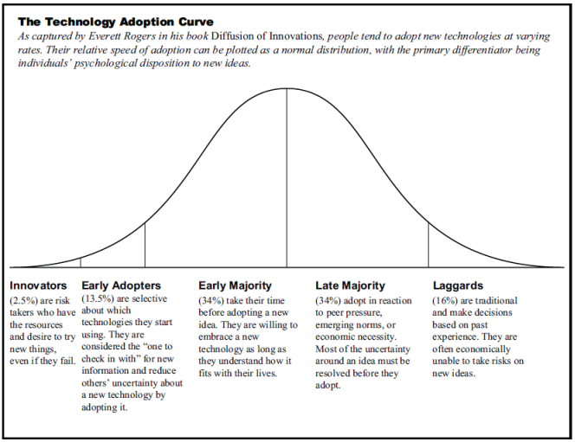
NEO Blockchain as a Enterprise Application Platform
Like any new platform…
Scalability
Reliability
Inexperience
Right tools
Knowledge
Education
Training
…

Slide 19
NEO is created for Large Scale dApps*
Mainchain speeds
NEO 1000 – 10,000 TPS (single core)
BTC 3 – 4 TPS
ETH 10 – 20 TPS
No transaction fees Initial 10 GAS fee is for free. Simple Smart Contracts can be run for free.
More freedom for application developers to choose the business model that most suits to their business. Service and usage fees can be charged in any way off-chain.
Confirmations needed
NEO 1 and only 1
BTC 6+
ETH 20+
*dApps – Distributed Apps

Slide 20
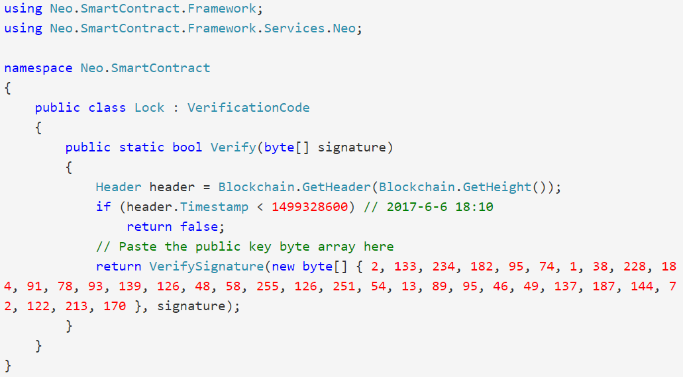
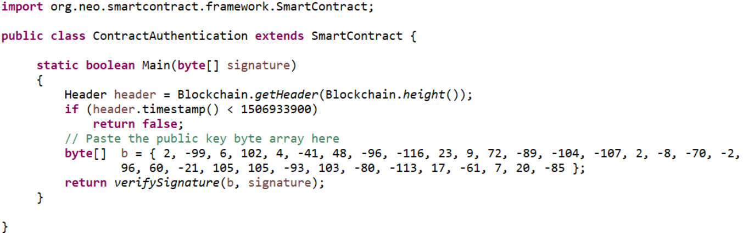
Smart Contracts: “Have it your way”

Slide 21




NeoX: Allowing Private-Public Exchanges
ONT
DNA
ONT
ONT
DNA
DNA

Slide 22

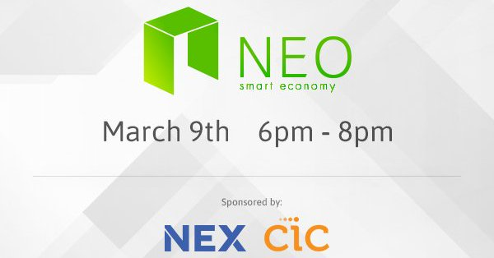

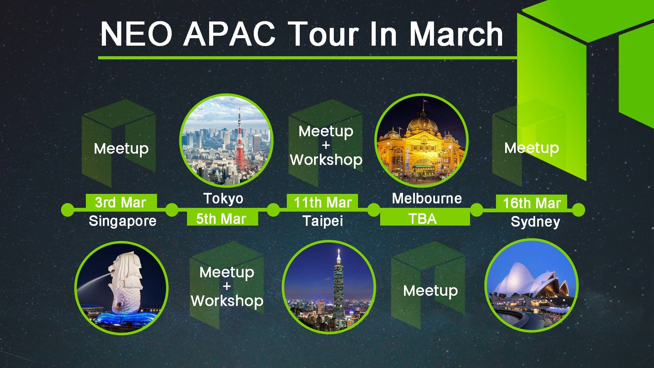
NEO Events
Second Wednesday evening of each month
HackCU Episode IV · University of Colorado Boulder
600 Hackers · 24 Hours · February 24th and 25th 2018

Slide 23
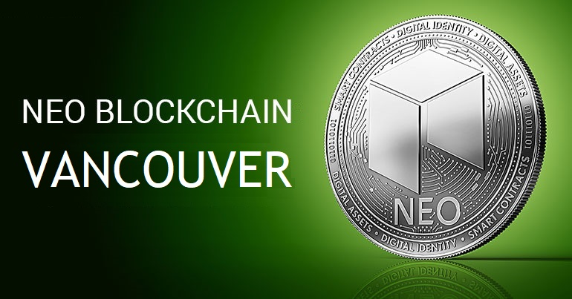
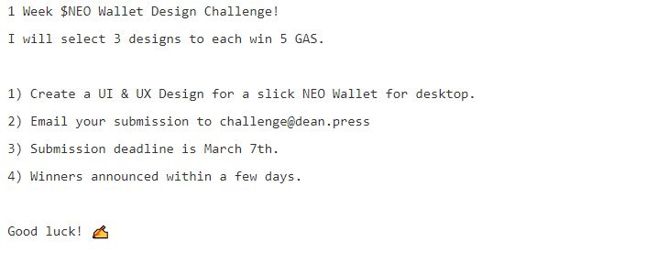
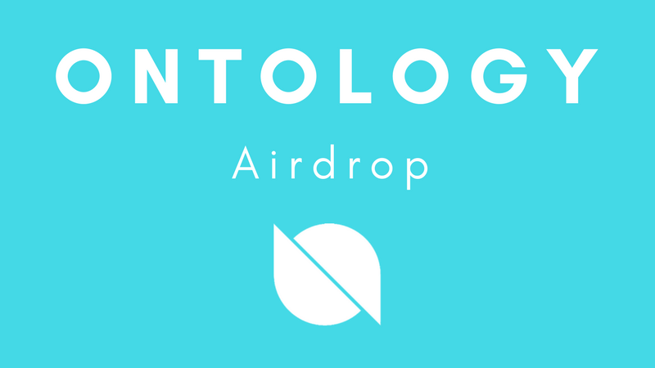

NEO Events (con’t)
Second Thursday evening of each month

Slide 24
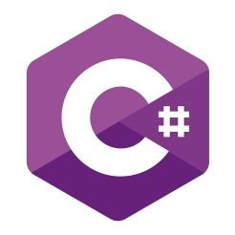
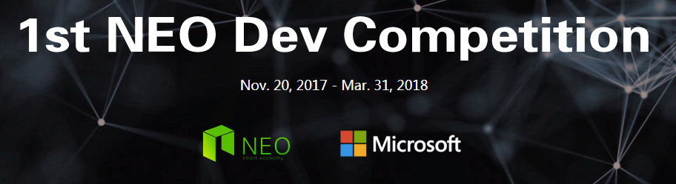


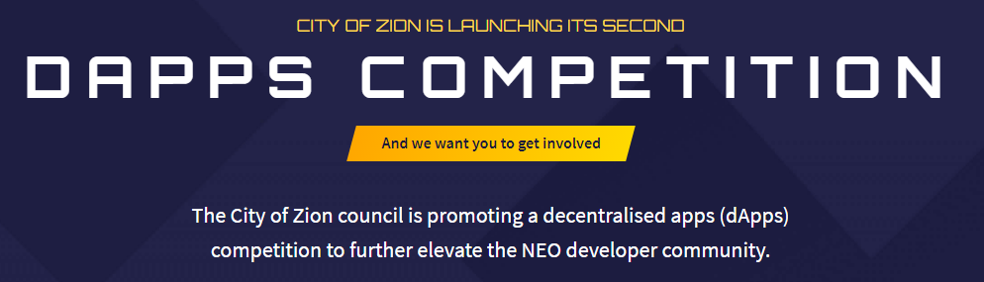

NEO dApp Competitions ~USD$500K in prizes

Slide 25
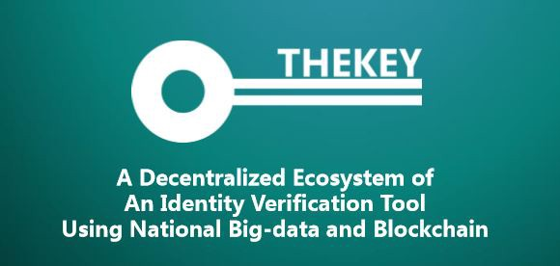
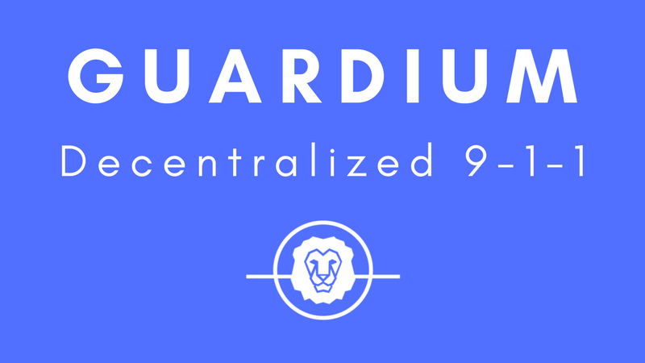


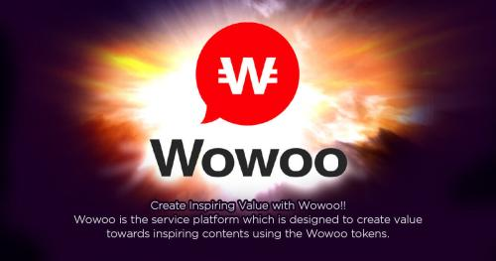
NEO News: Switchers
[QTUM to NEO] THEKEY, a Decentralized Ecosystem of Identity Verification Tool Using National Big-data and [NEO] Blockchain https://www.reddit.com/r/NEO/comments/7areac/ama_on_9th_nov_thekey_a_decentralized_ecosystem/
[Blockchain agnostic strategy] Jibrel Network founder looking to switch from Ethereum to NEO https://imgur.com/oHYTYi2
[ETH to NEO] Guardian Circle announce switch to NEO platform https://neonewstoday.com/general/guardium-announce-switch-to-neo-platform/ “...the more we dug into NEO, the more we realized that they had really great answers to every one of our concerns with Ethereum and many additional benefits that are unique to the NEO ecosystem.”
[ETH to NEO] Narrative project: Big News: KYC and Our Switch to NEO https://blog.narrative.network/big-news-kyc-and-our-switch-to-neo-2f34215beef9
[ETH to NEO] Concierge.io NEO Token Sale https://medium.com/@concierge.io/concierge-io-neo-token-sale-f870a0a27b04
[ETH to NEO] IMPORTANT NEWS FOR THE WOWOO COMMUNITY http://wowoonet.com/news.html#news_2018_6
[ETH to NEO] Three things to consider when choosing a blockchain for your project — or why Veris chose NEO. https://medium.com/verisfoundation/three-things-to-consider-when-choosing-a-blockchain-for-your-project-or-why-veris-chose-neo-b4483135c382

Slide 26
What is NEO? Summary
For large scale decentralized applications, transaction cost, transaction time (including confirmations) is a big obstacle and restriction to possible business models.
NEO is built for large scale dApps and is free to use for the end user. Fees (GAS) are instead charged for deploying contracts and registering assets.
Transaction volume is not an issue with 1000TPS+ on main chain and plenty off-chain scaling possibilites.
NeoX will make the NEO ecosystem quite unique. NEO contain the public ledger for digital assets, identity and smart contracts.

Slide 27
NEO Resources: Videos and Webcasts
The New Vision - Da Hongfei https://www.youtube.com/watch?v=th7jZlmoZBc
Malcolm Lerider: Clarification on NEO, GAS and Consensus Nodes https://www.youtube.com/watch?v=iV4WREWtCiI
A Deep Dive into NeoVM & NeoContract [English Subtitles] https://www.youtube.com/watch?v=fLppte-guYE
NEO Persistable Classes (NPC) e-dApp Smart Contract Platform 2.0: Deep Dive https://www.youtube.com/watch?v=Nj4-m2o94VE

Slide 28
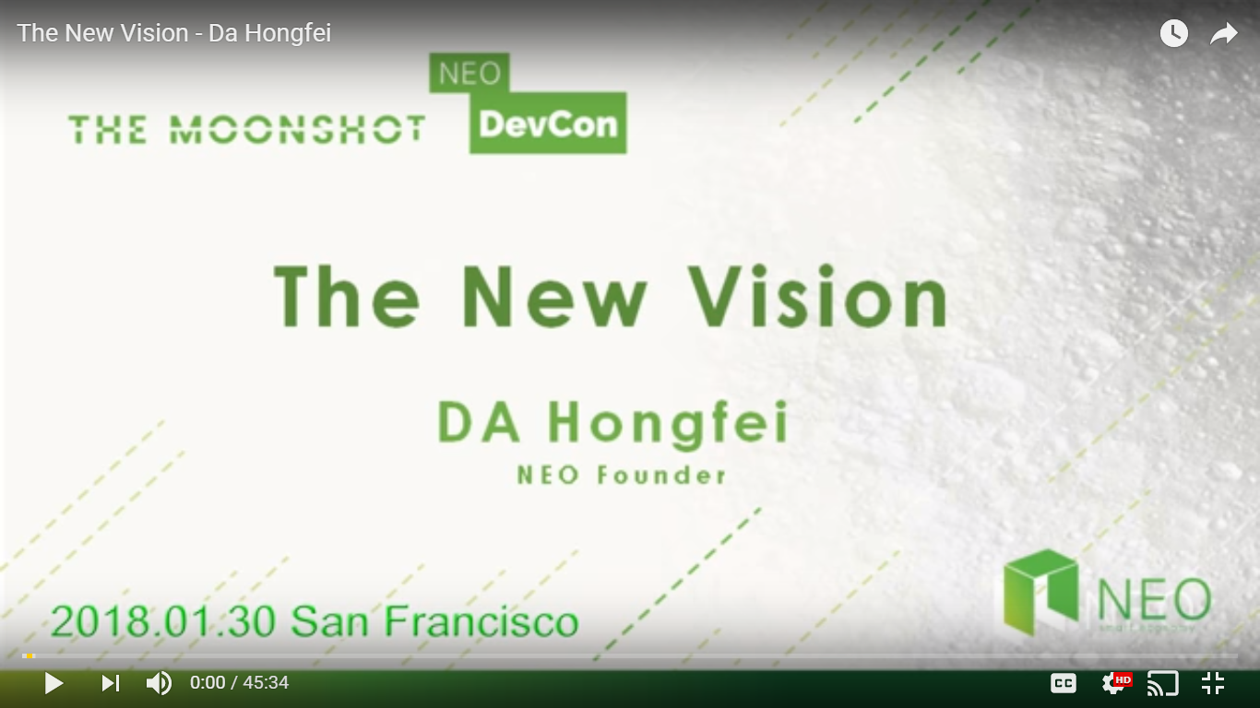
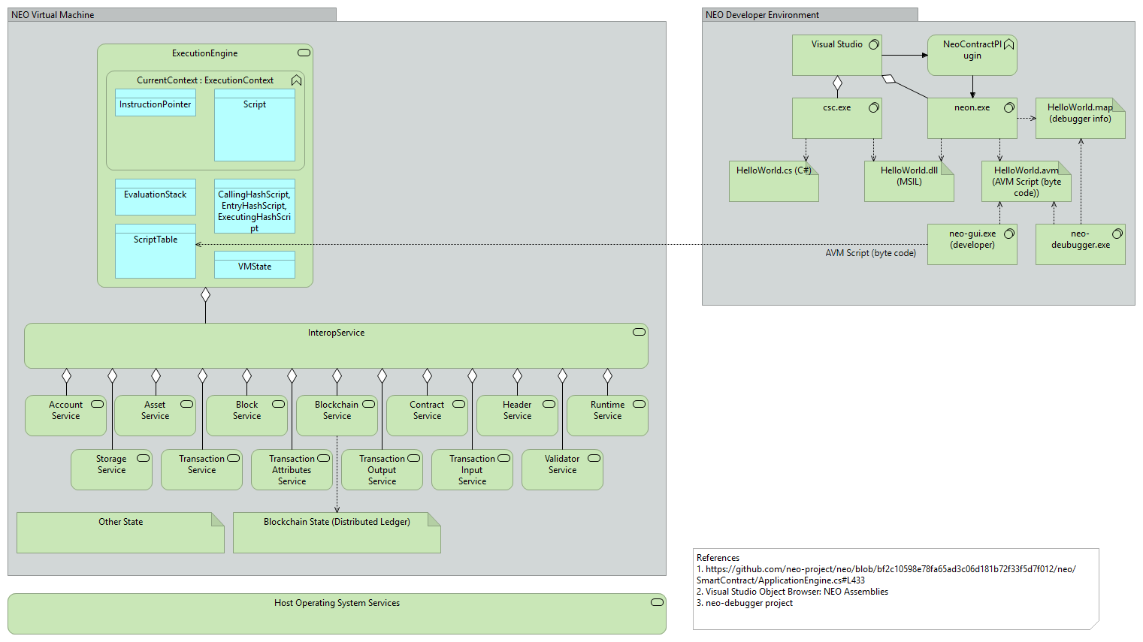
NEO Resources
General
NEO.org http://neo.org
NEO Tutorials (C#, Java, Python), API docs http://docs.neo.org
NEO Devcon “Th New Vision” Keynote by NEO Founder https://www.youtube.com/watch?time_continue=3&v=th7jZlmoZBc
Developers
N NEO C# Developers Center of Excellence (neo-csharpcoe) https://github.com/mwherman2000/neo-csharpcoe/blob/master/README.md
Discord NEO Community (like Slack) https://discord.gg/gqCYeup
The NEO Project https://github.com/neo-project
City of Zion awesome-neo project: Developer Docs https://github.com/CityOfZion/awesome-neo/ #developer-documentation

Slide 29
NEO Blockchain C# Developers Center of Excellence https://github.com/mwherman2000/neo-csharpcoe
Founder: Michael Herman (neotoronto@outlook.com)
NEO Blockchain end-to-end, detailed guidance for .NET developers
Content purposely designed to help .NET developers ramp up and become productive more quickly
Repository for content presented at the NEO Blockchain Toronto meetup group
Contents
NEO Blockchain Quick Start Guide for .NET Developers https://github.com/mwherman2000/neo-windocs/tree/master/windocs/quickstart-csharp/README.md
NEO Blockchain Architecture Reference Model (ARM) for .NET Developers (neo-charm) https://github.com/mwherman2000/neo-windocs/blob/master/windocs/neo-charm/README.md
NEO Blockchain Toronto https://github.com/mwherman2000/neo-windocs/tree/master/events/2018-neo-blockchain-toronto

Slide 30
NEO Blockchain Architecture Reference Model (ARM) for .NET Developers (neo-charm) https://github.com/mwherman2000/neo-charm/ blob/master/README.md

Slide 31
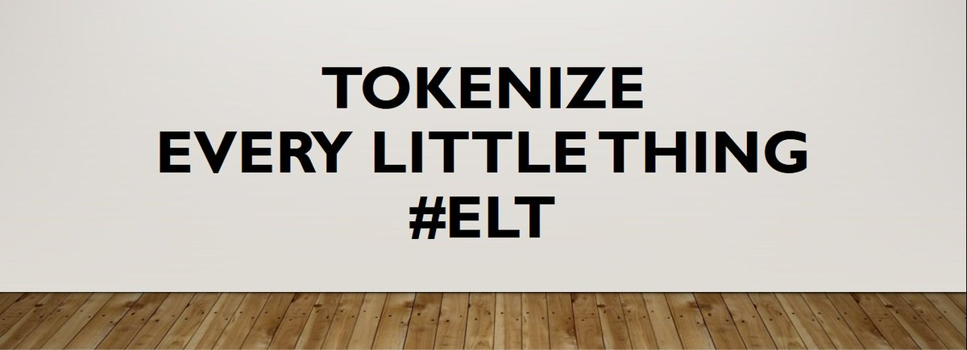
I leave you with a challenge… Become part of the NEO Smart Economy
hyperonomy.com – digital intelligence (my blog)
https://hyperonomy.com/2018/01/24/tokenization-of-every-little-thing-elt/

Slide 32

Questions?
Happy St. Patrick’s Day
Neoxplorers!
Thank you for coming out this evening

